Slide 1

-01-

Slide 2


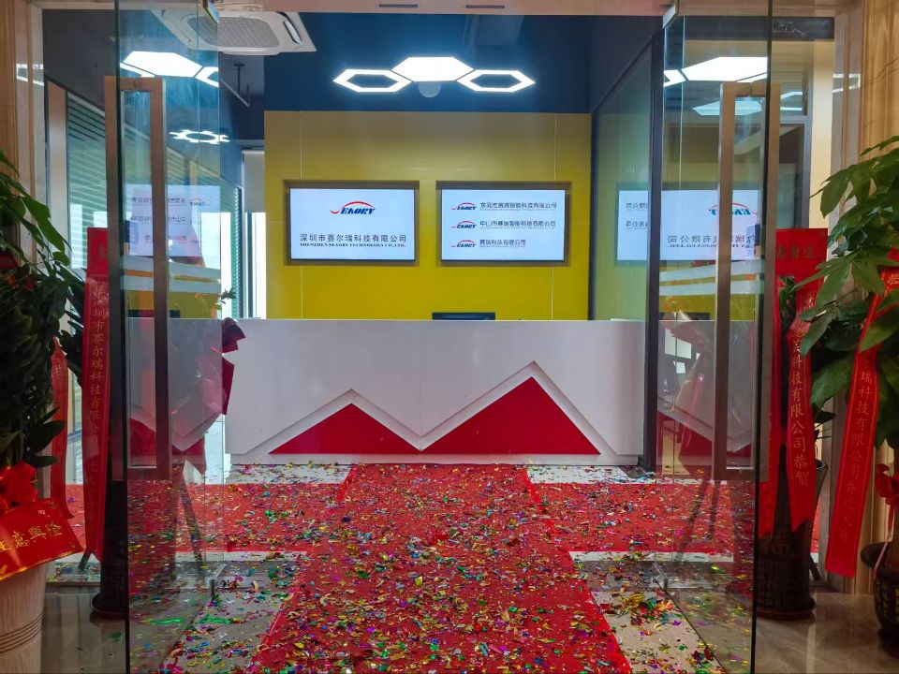
CONTENT
1
About Seaory
2
Seaory Products
3
Seaory Soft Power

Slide 3
1
About Seaory
-03-

Slide 4

Company Profile
SHENZHEN SEAORY TECHNOLOGY CO., LTD is a high-tech company which has been specializing in the R&D, manufacturing and sales of smart cards, RFID labels and card printers.
Our headquarter is located in Shenzhen,the most leading-edge and innovative city in China's Science and Technology field, we also have branches in Dongguan and Zhongshan city respectively.
For Seaory personalization card printers, mainly includes D-T-C card printers, Retransfer card printers and Portable Card Dispenser that we have completely independent intellectual property rights. Meanwhile “Seaory” brand has been registered in the world's most major economies, and the products have obtained a number of Chinese and global patents.
-04-

Slide 5
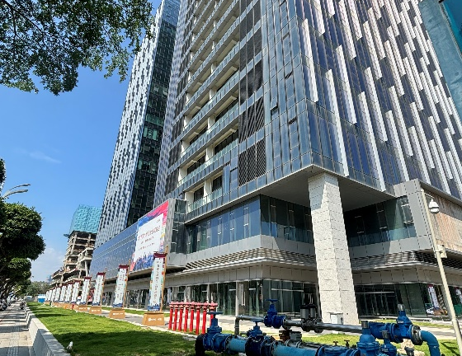
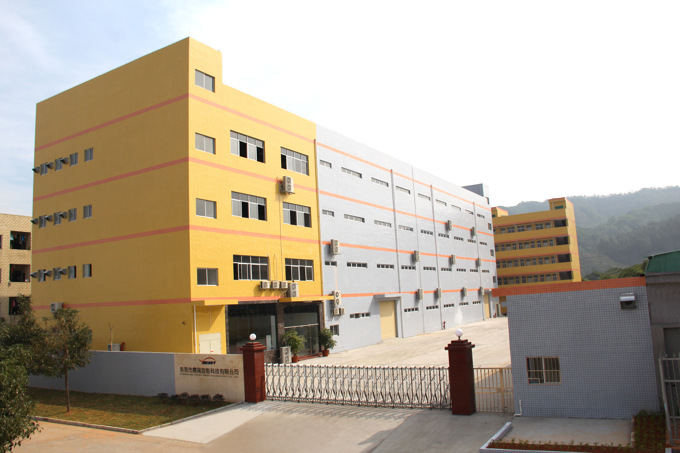
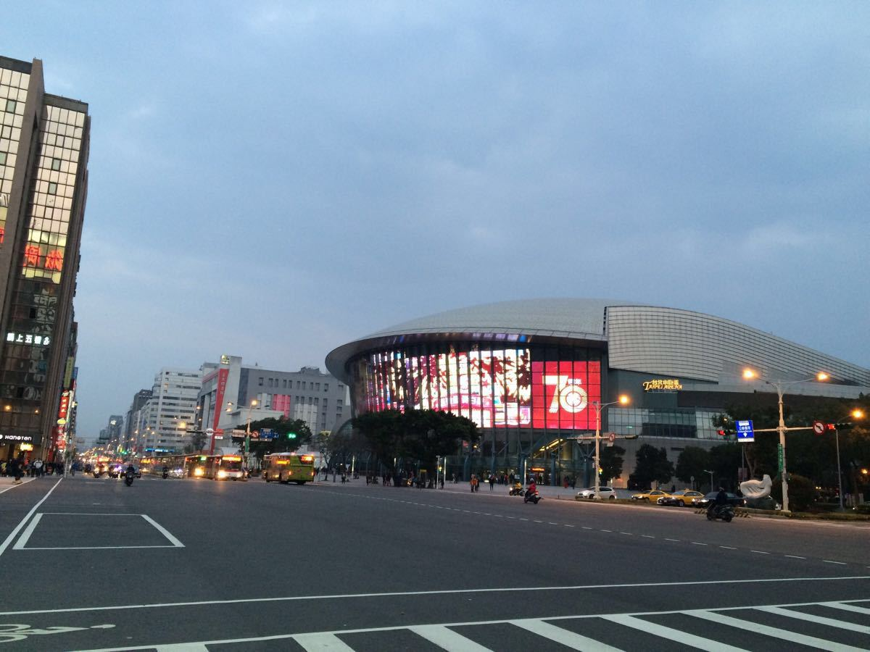
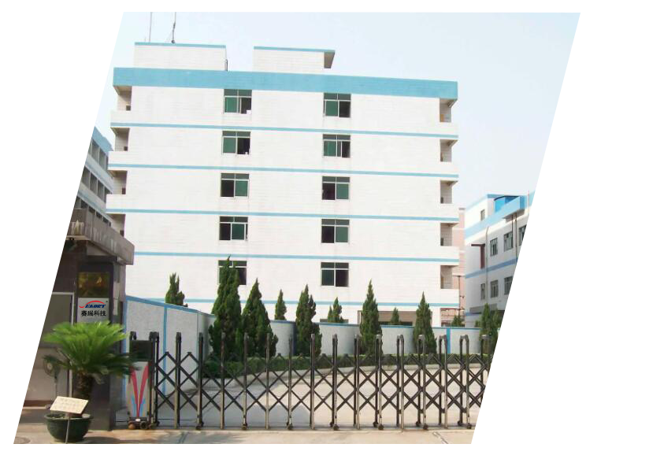
Extension Institutions
Shenzhen
Headquarters
Founded in 2002
Dongguang
Smart Card Factory
Founded in 2011
Taiwan
R&D Center
Established in 2017
Zhongshan
Card Printer Factory
Founded in 2023
-05-
-04-

Slide 6

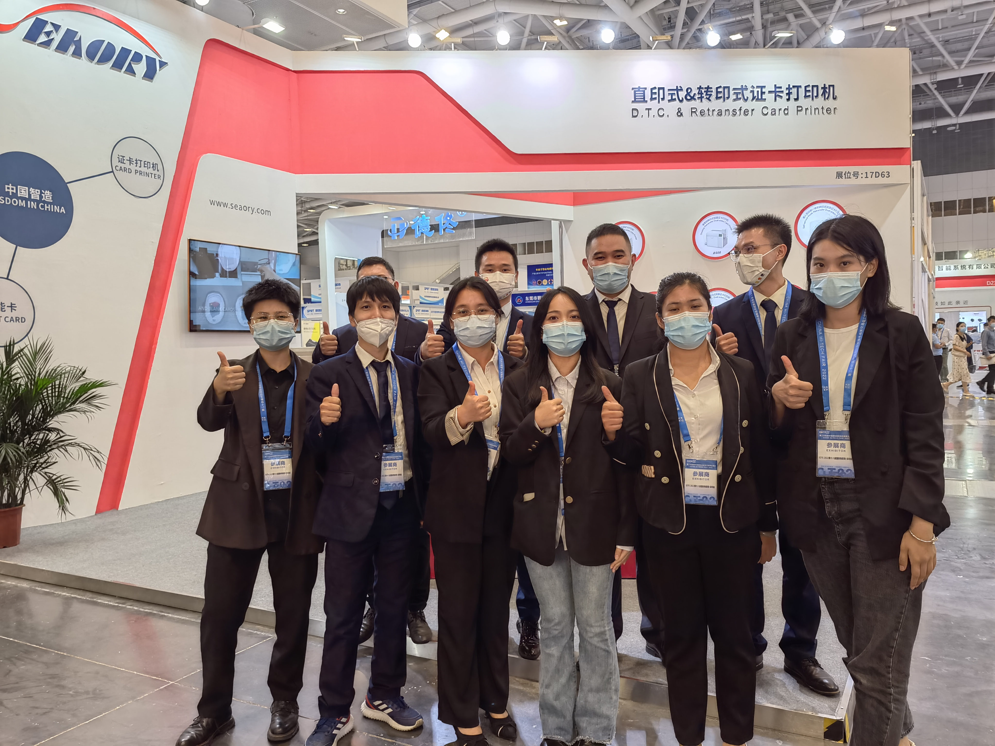
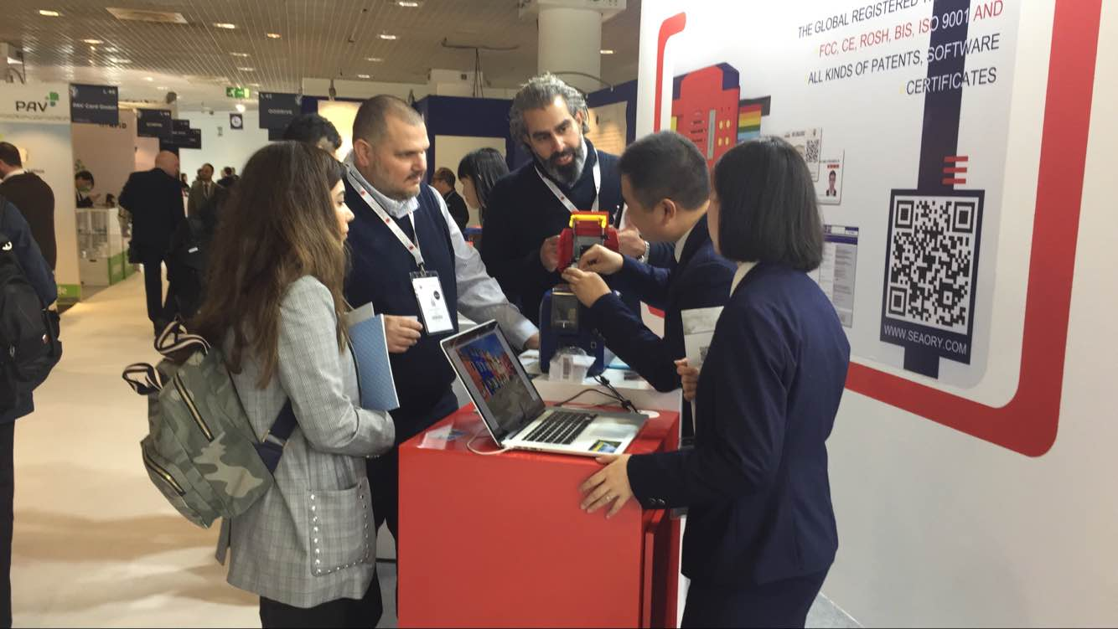
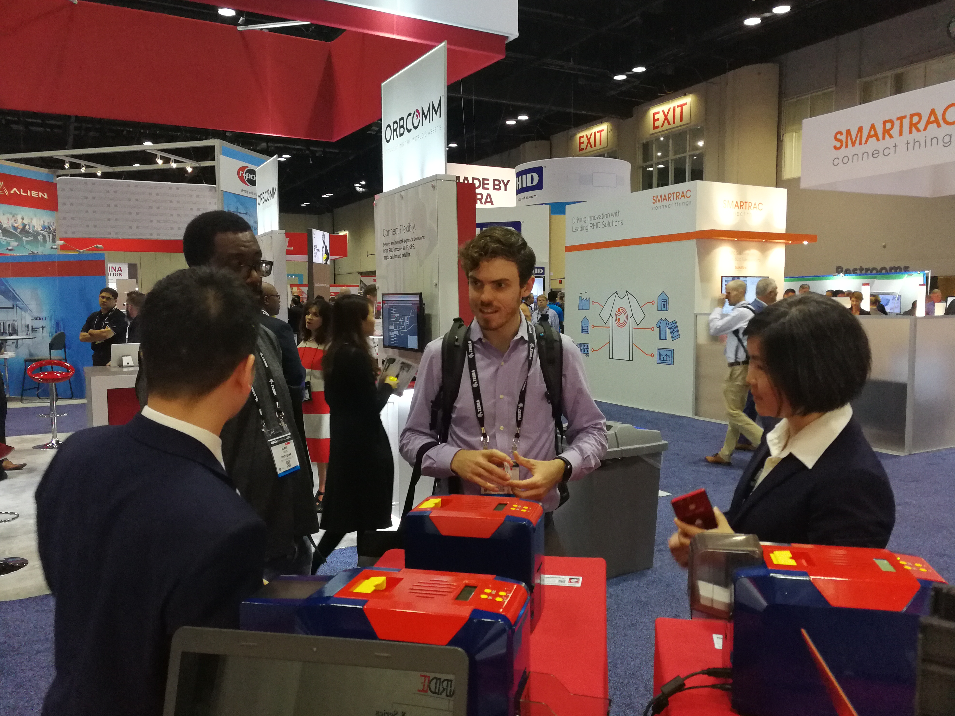
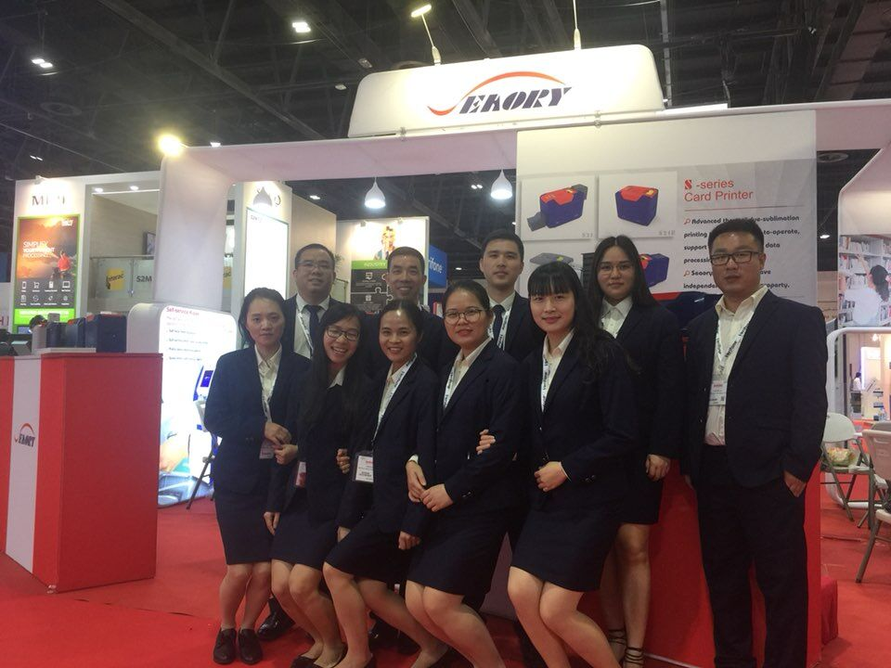
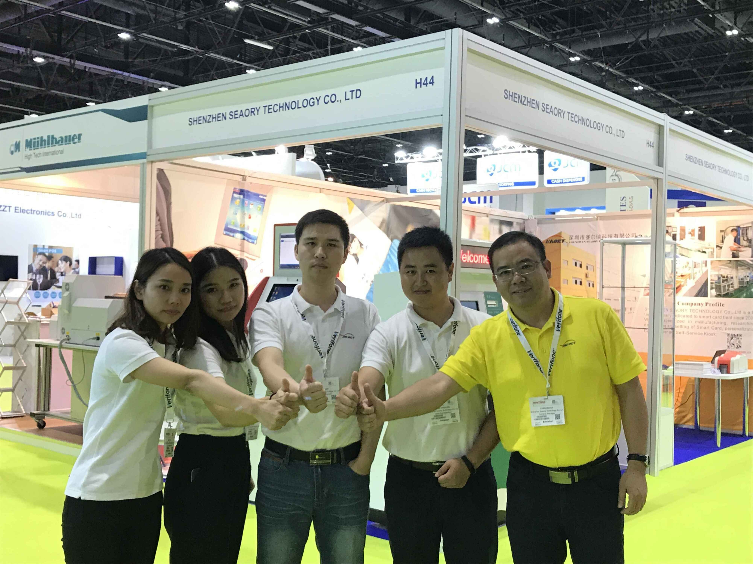
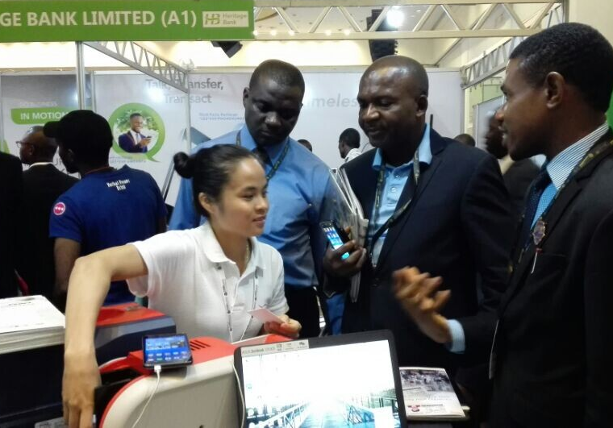
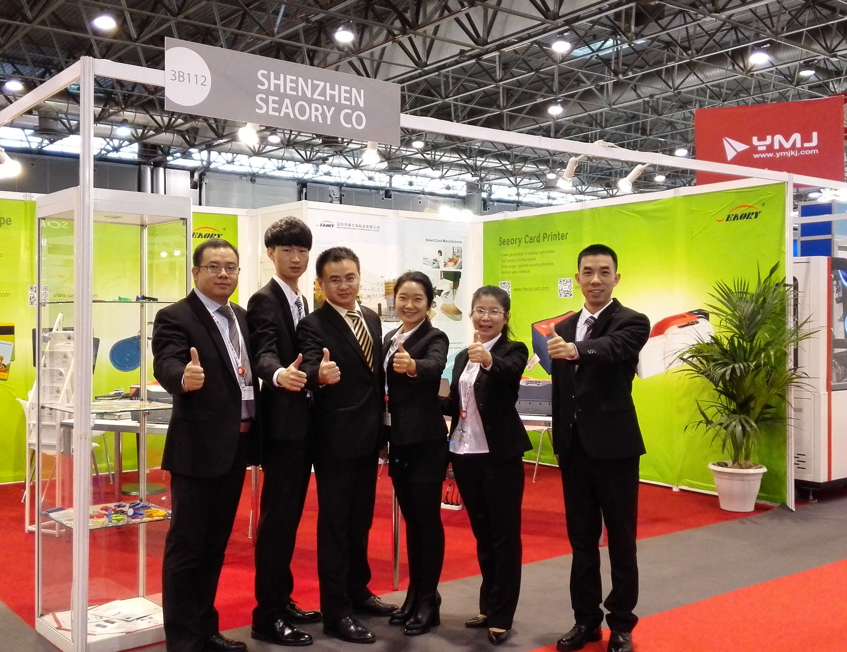
30+ Exhibitions around the world over past 10 years
2023 France
2022 Shenzhen
2019 France
2018 America
2018 Dubai
2017 Dubai
2017 Nigeria
2015 France
-08-

Slide 7
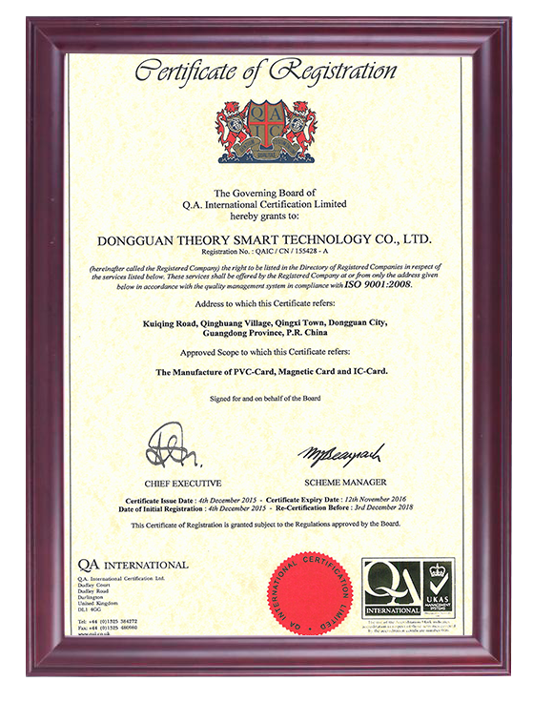

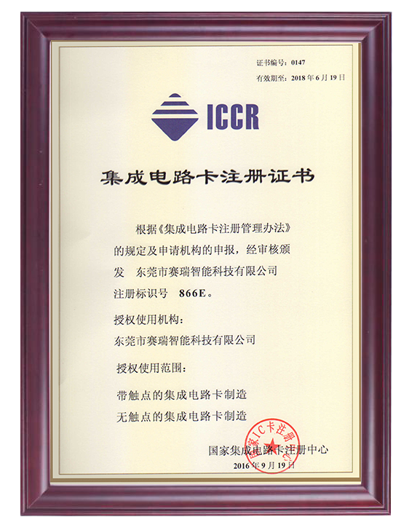
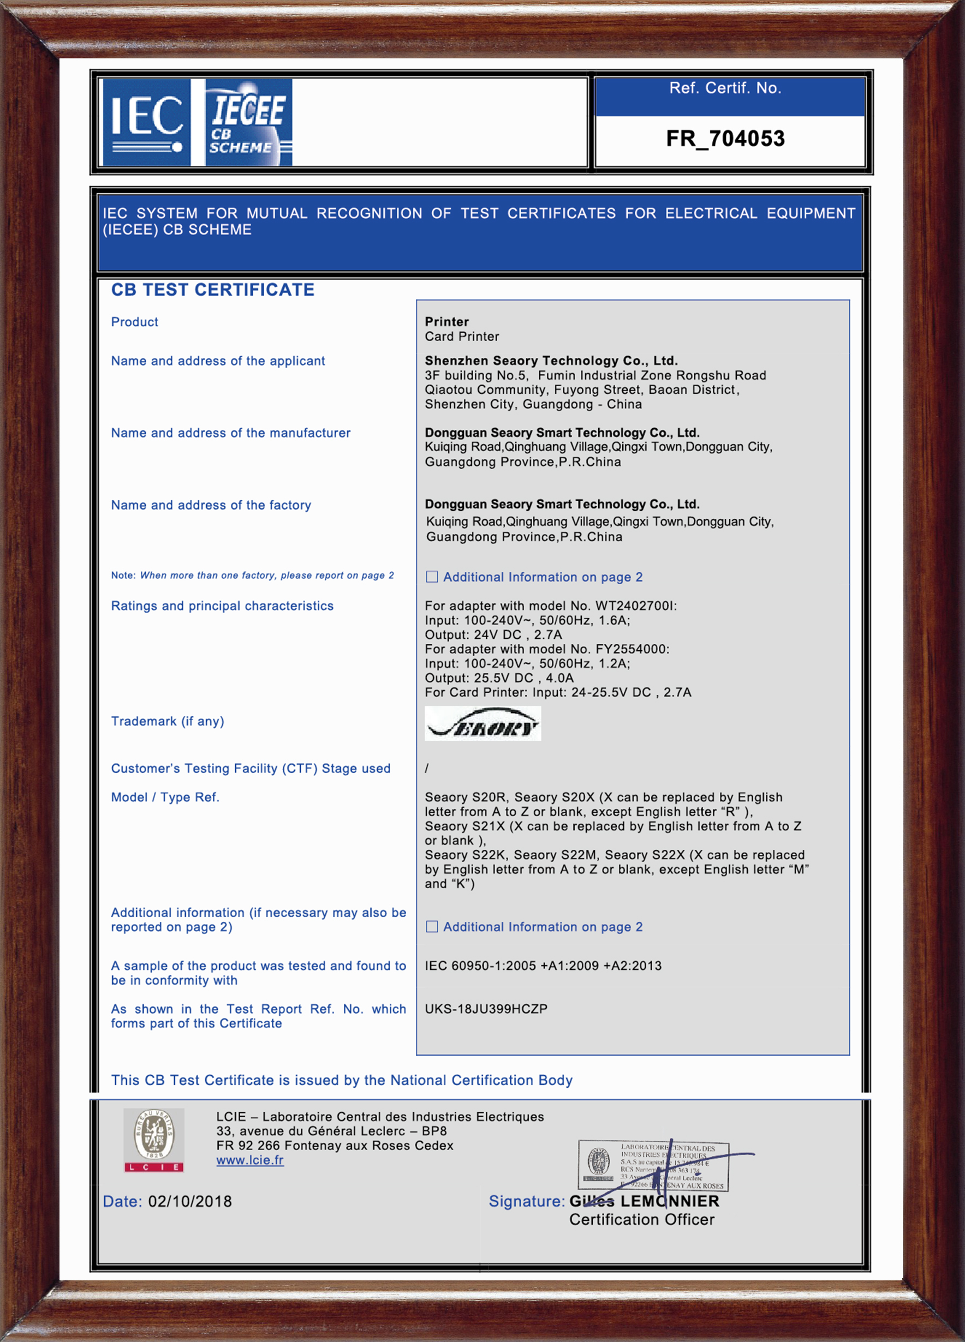
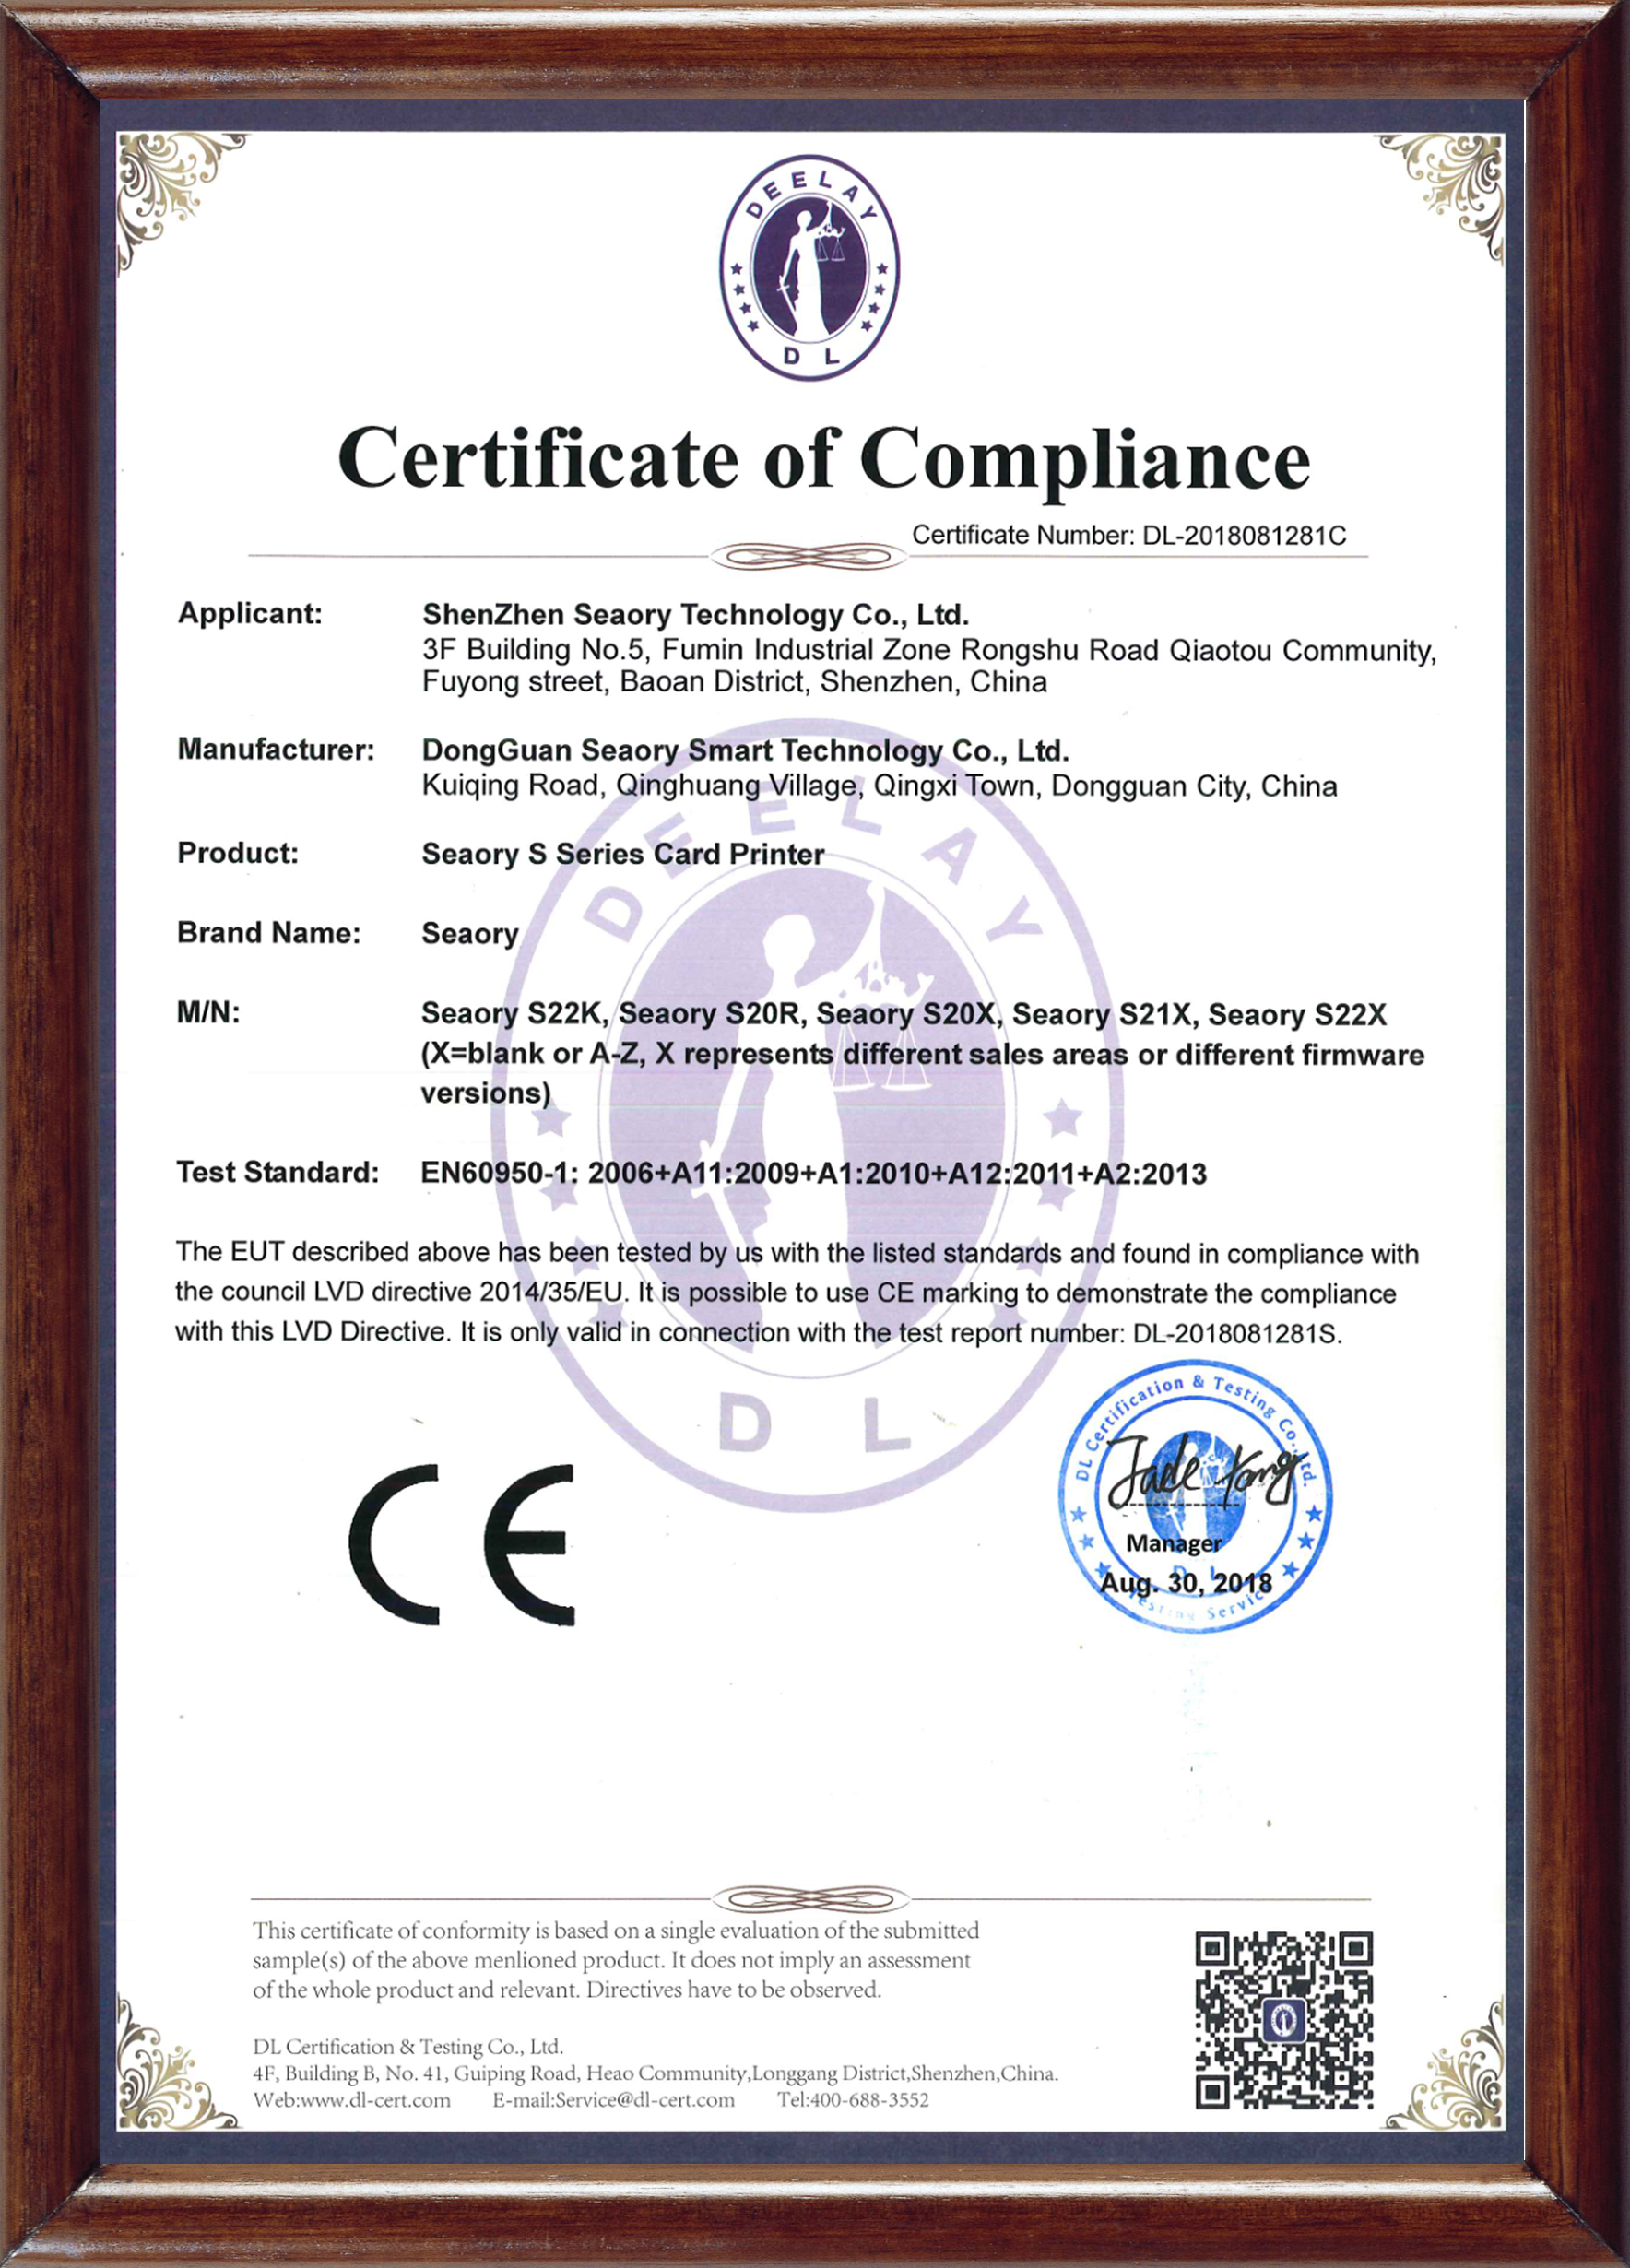



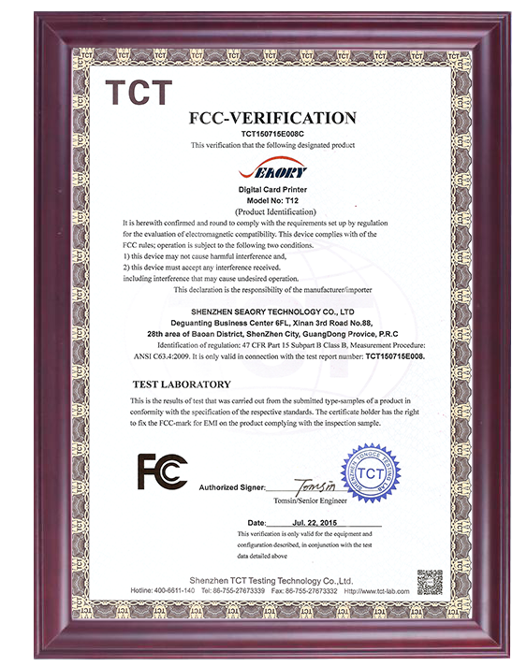

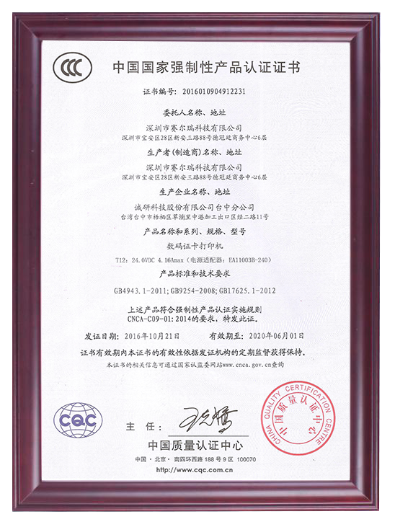

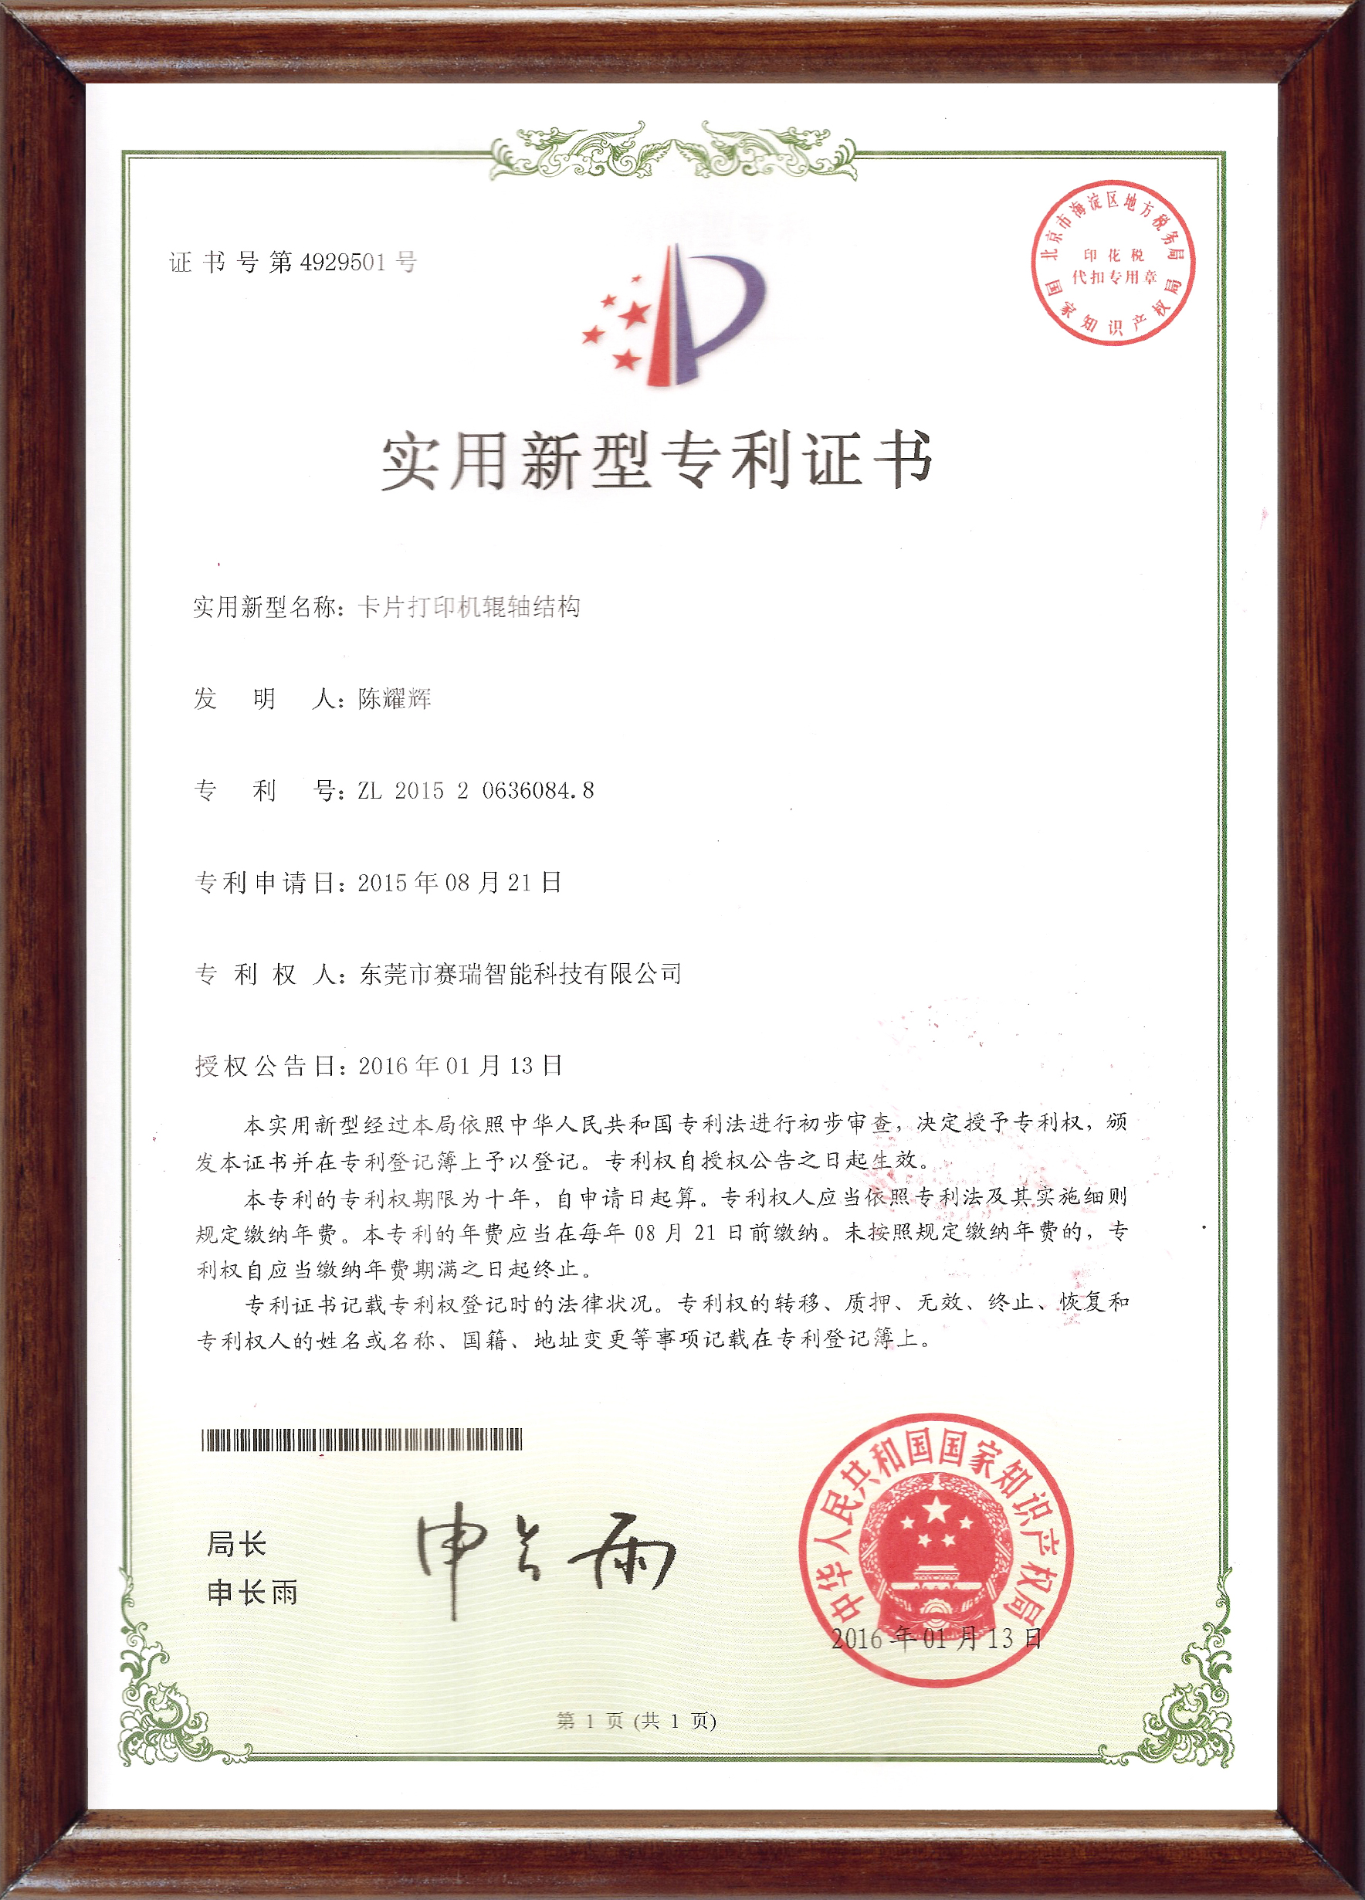

Certifications
ISO9001
QA International certification
The integrated circuit license
CB
LVD
BIS
UKCA
CE
FCC
RoHS
CCC
Patents
-09-

Slide 8
2
Seaory Products
-10-

Slide 9
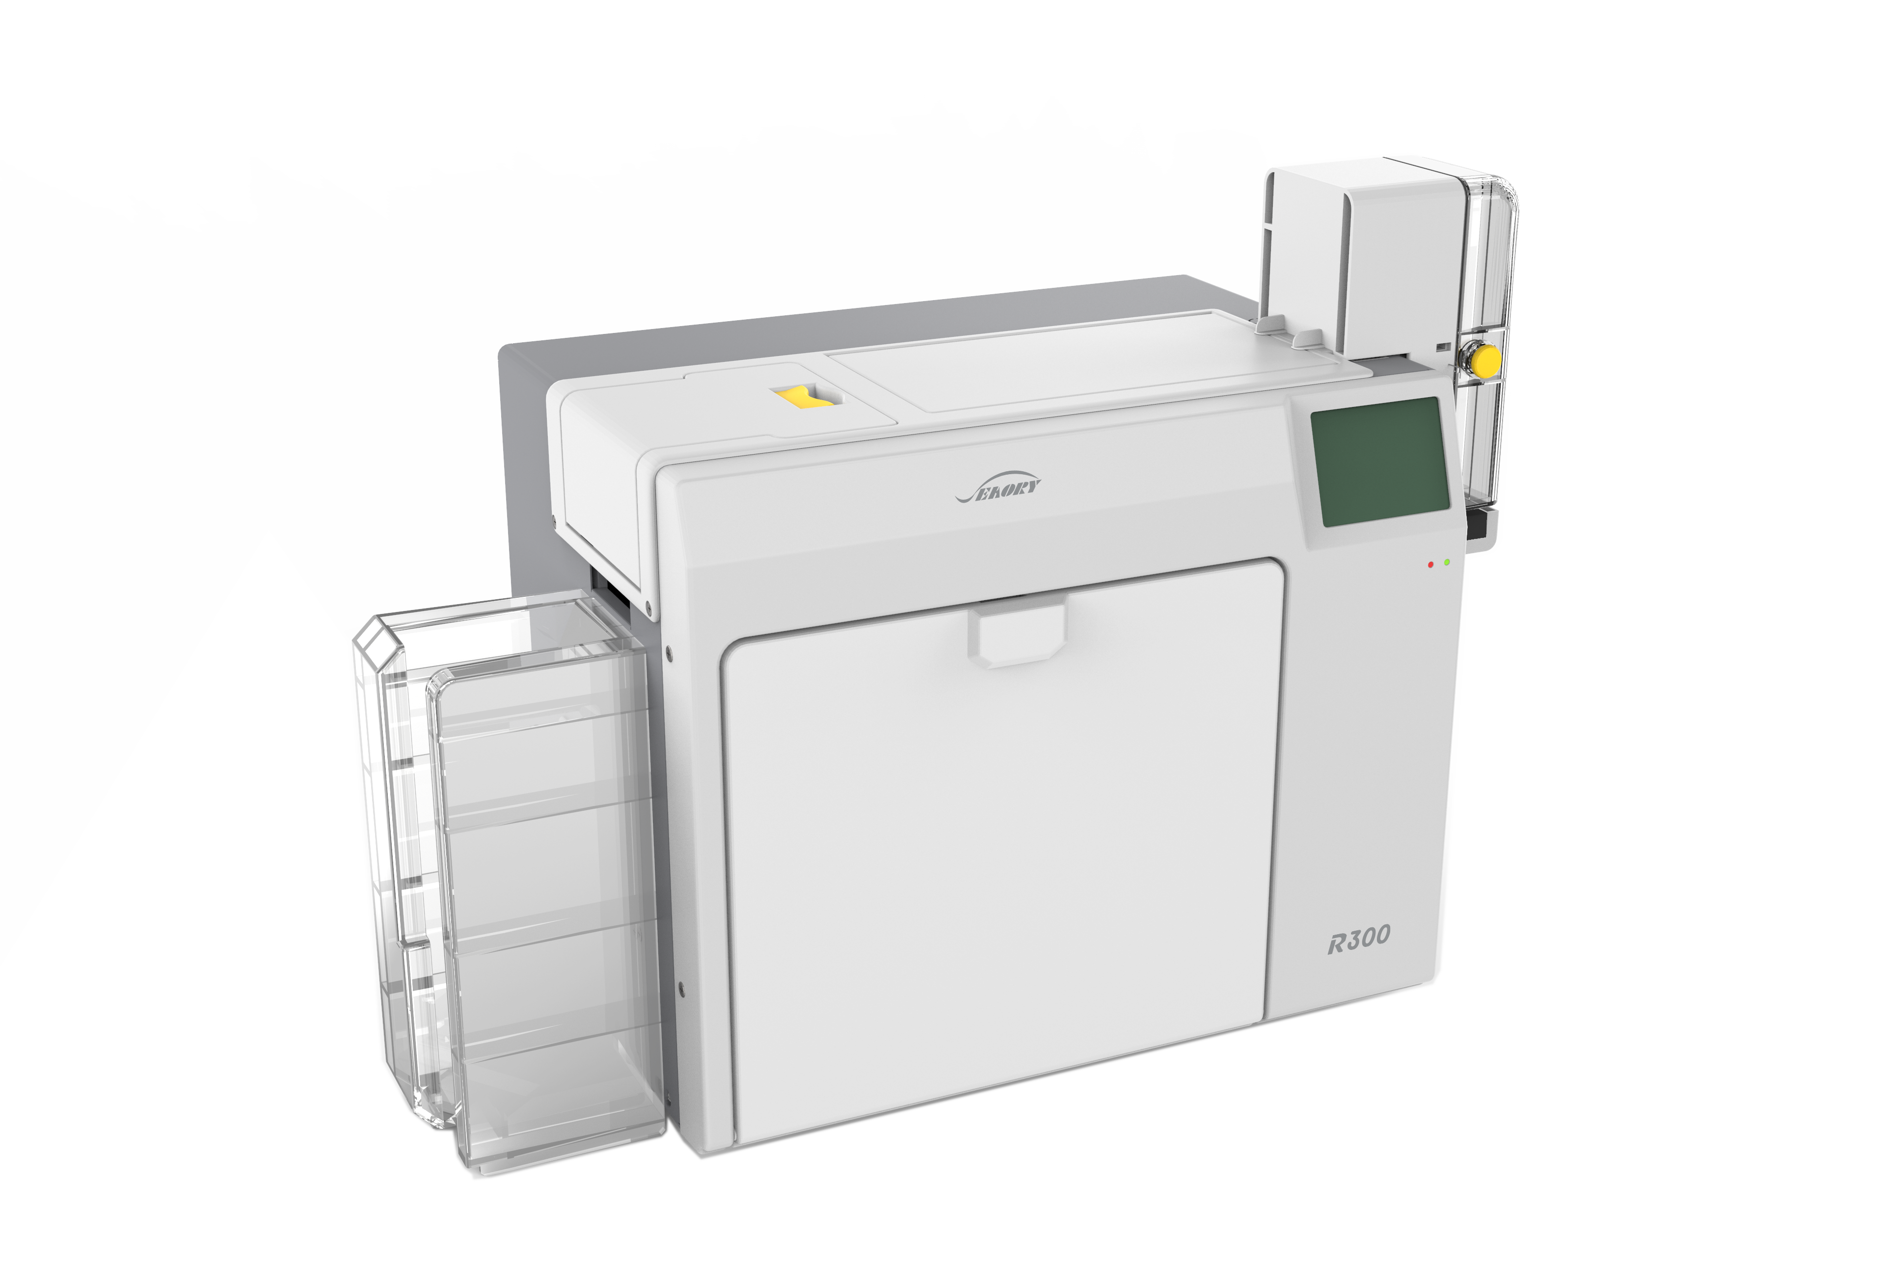
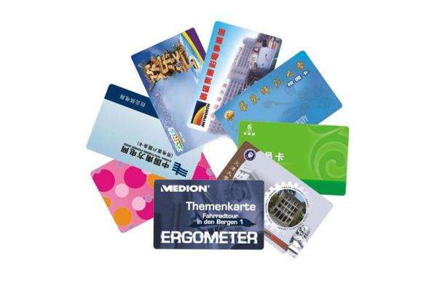
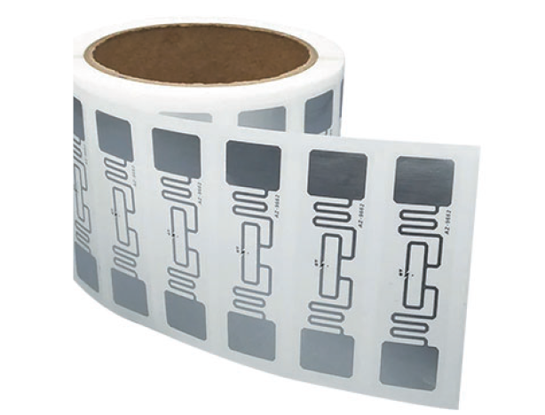
Seaory Products
Smart Cards
Card Printers
RFID Labels
-11-

Slide 10
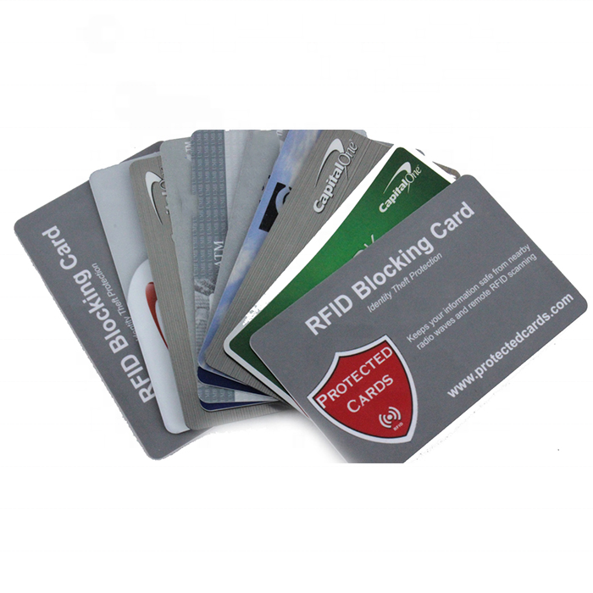
Smart card
Smart Card can help your business
Marketing Cards Gift Cards Student IDs Golf Bag Tags Clear PVC Cards Proximity Cards Id Cards and Badges | Luggage Tags Phone Cards Membership Cards Business Cards Promotional Cards Loyalty Cards Discount Cards
-13-

Slide 11
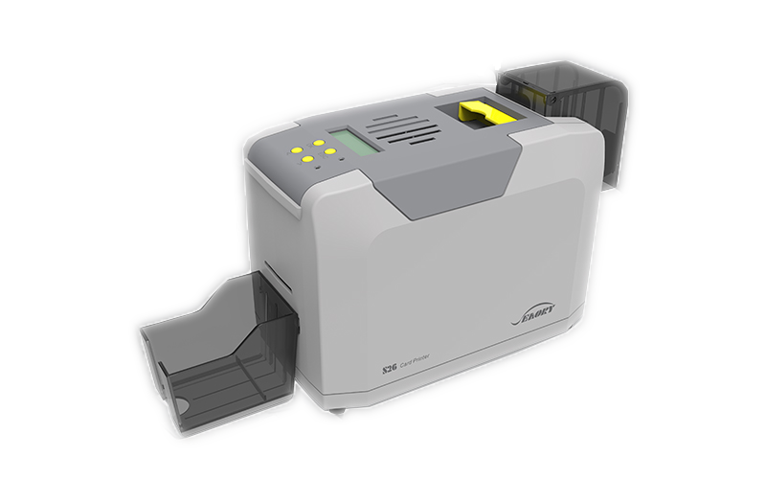
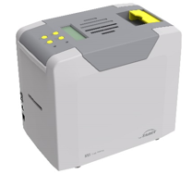
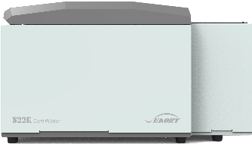
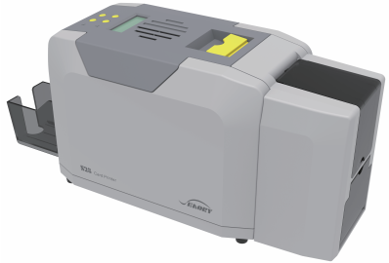
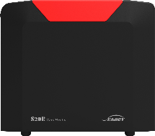
Seaory S series D-T-C Card Printer
Pictures
Model | S22K(Dual-side) | S28(Dual-sided) | S26(Single-sided) | S25(Single-sided) | S20R(Single-sided)
Features | 1. Interface: USB,Ethernet,RS232 2. Input Capacity: Standard100 cards, High Hopper 400 cards, Lock Hopper 200 cards 3. Print Speed: Monochrome single side 3~5s/card, dual side 7~12s/card, Full-color(YMCKO) single side 20s/card, dual side 42s/card 4. Print Dimention: ISO CR80(53.98mm*85.6mm) 5. Print Resolution: Standard 300*300 dpi, (300*600, 300*1200 optional) 6. Warranty: 24 months(print head replace onefor free within 1 year) | 1. Interface: USB2.0, Ethernet 2. Input Capacity: 100 cards, Output Capacity: 50 cards 3. Print Speed: Monochrome single side 3~5s/card, dual side 7~9s/card, Full-color(YMCKO) single side 18s/card, dual side 37s/card 4. Print Dimention: ISO CR80(53.98mm*85.6mm) 5. Print Resolution: 300*300, 300*600, 300*1200 6. Warranty: 24 months(print head replace onefor free within 1 year) | 1. Interface: USB2.0, Ethernet 2. Input Capacity: 100 cards, Output Capacity: 50 cards 3. Print Speed: Monochrome : single side 3~5s/card Full-color(YMCKO) : single side 18s/card, 4. Print Dimention: ISO CR80(53.98mm*85.6mm) 5. Print Resolution: 300*300, 300*600, 300*1200 6. Warranty: 24 months(print head replace onefor free within 1 year) | 1. Interface: USB2.0 2. Input Capacity: Manual Output Capacity: -- 3. Print Speed: Monochrome : single side 3~5s/card Full-color(YMCKO) : single side 18s/card, 4. Print Dimention: ISO CR80(53.98mm*85.6mm) 5. Print Resolution: 300*300, 300*600, 300*1200 6. Warranty: 24 months(print head replace onefor free within 1 year) | 1. Interface: USB2.0 2. Input Capacity: Manual Output Capacity: -- 3. Print Speed: Rewrite card printer erasing speed 6s/card 4. Print Dimention: ISO CR80(53.98mm*85.6mm) 5. Print Resolution: Standard 300*300 dpi, (300*600, 300*1200 optional) 6. Warranty: 24 months(print head replace onefor free within 1 year)
Optional Multi-functional module | 1. Dual interface chip card encoding module 2. Contactless ID card encoding module 3. UHF chip card encoding module 4. Magnetic stripe card encoding module | 1. Dual interface chip card encoding module 2. Contactless ID card encoding module 3. UHF chip card encoding module 4. Magnetic stripe card encoding module | 1. Dual interface chip card encoding module 2. Contactless ID card encoding module 3. UHF chip card encoding module 4. Magnetic stripe card encoding module | 1. Dual interface chip card encoding module 2. Contactless ID card encoding module 3. UHF chip card encoding module 4. Magnetic stripe card encoding module | 1. Single side printing 2. Front-end & back-end entry and exit cards Free settings 3. Manual single card feeding 4. No ribbon required, thermal printing
-14-

Slide 12
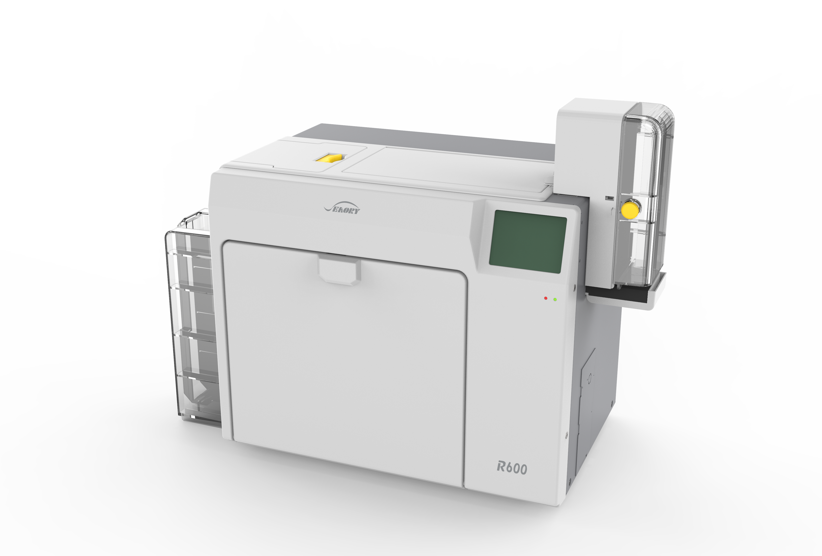
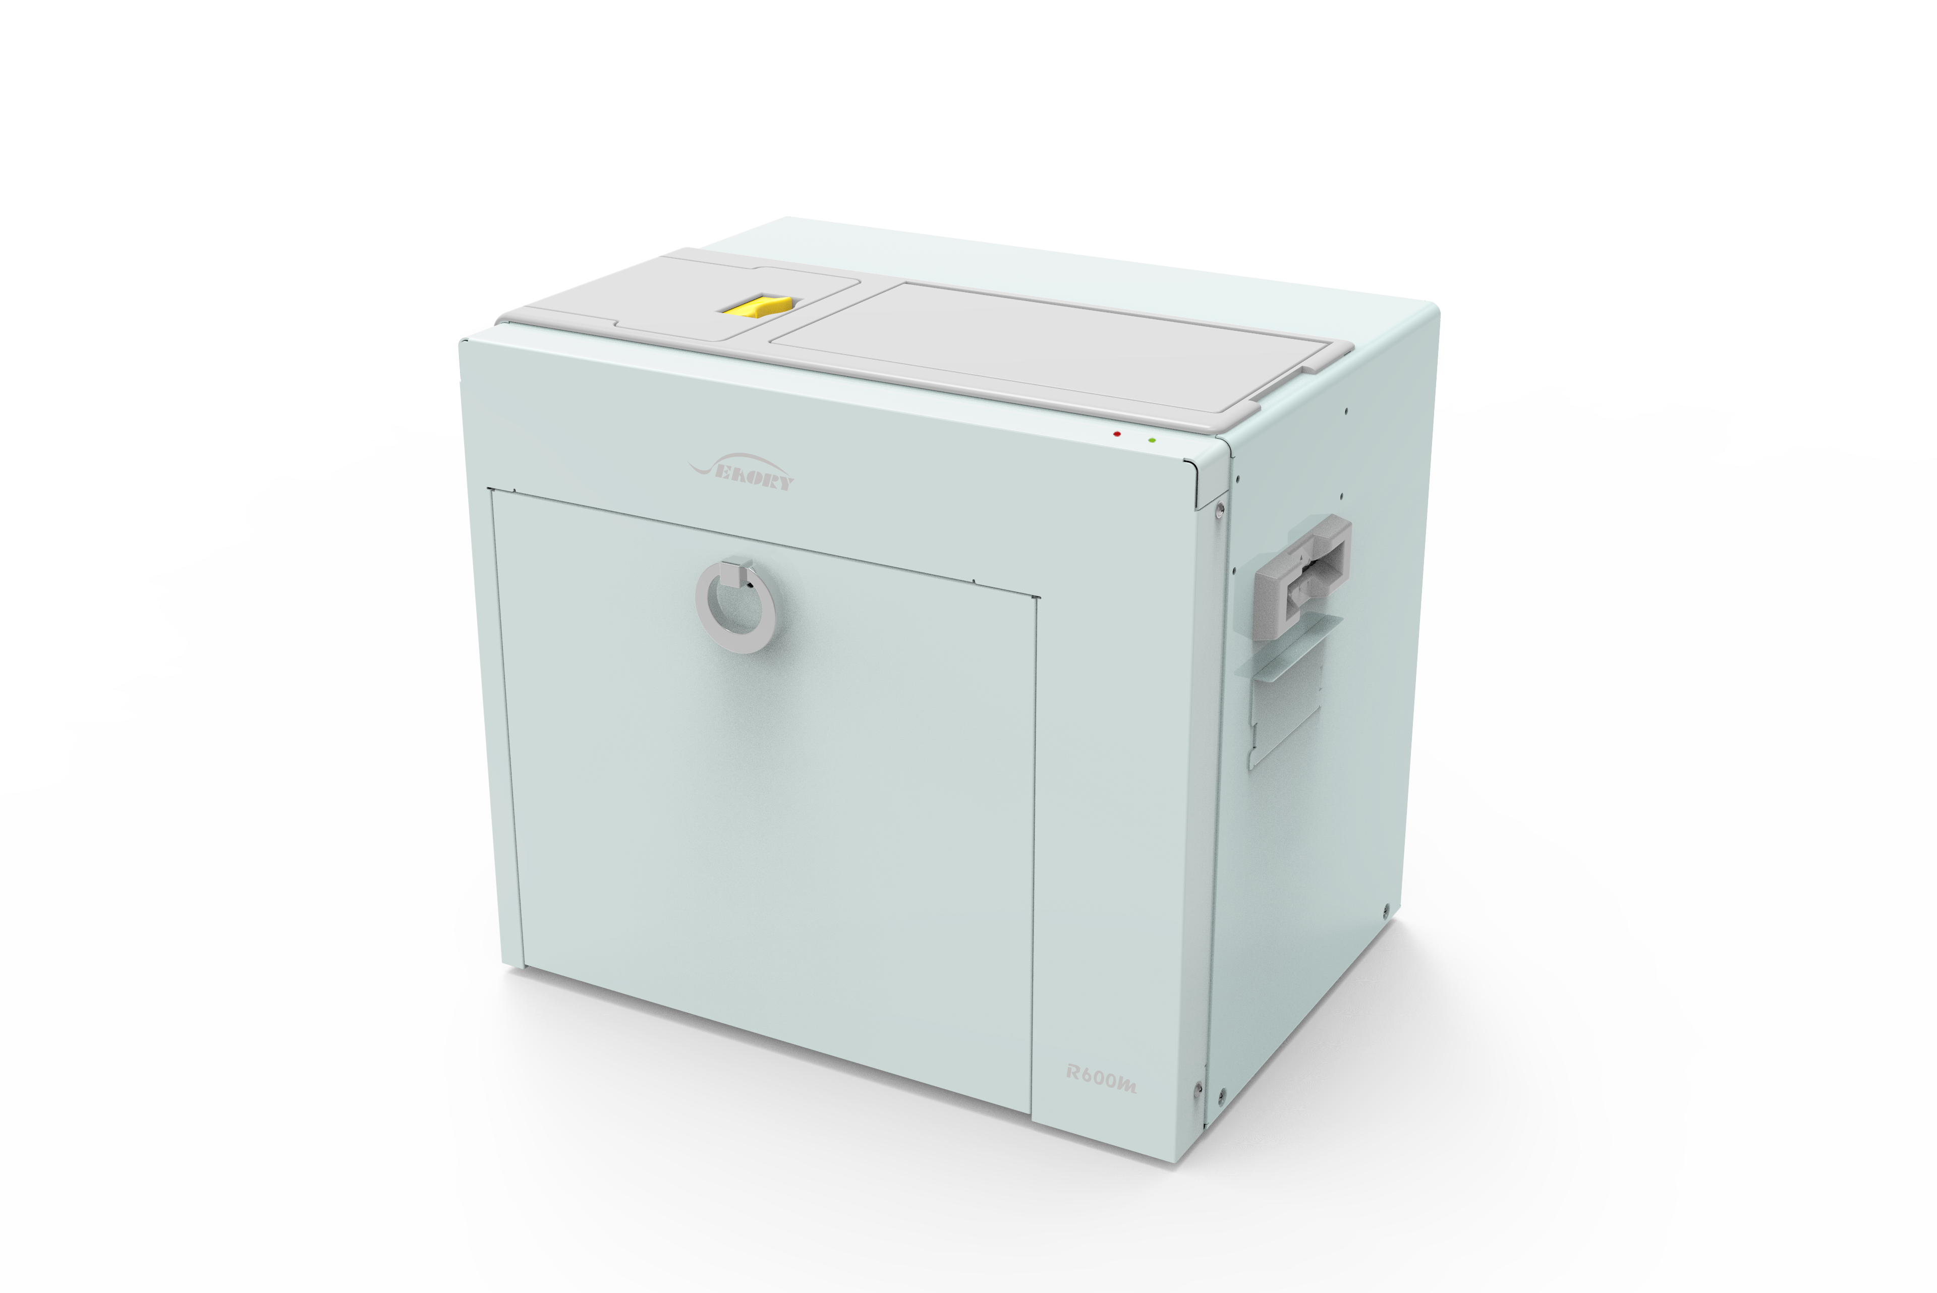
R series Retransfer Card Printer
Pictures
Model | R330 | R660 | R600M
Features | 1. Interface: USB,Ethernet,WIFI(Optional) 2. Input hopper capacity: 200 cards, Output hopper capacity: 200 cards, Defective card slot: 25 cards 3. Print Speed: Monochrome single side 12~16s/card, dual side 30~34s/card, Full-color(YMCK) single side 20s/card, dual side 38s/card 4. Print Dimention: ISO CR80(53.98mm*85.6mm) over-edge printing 5. Print Resolution: Standard 300*300 dpi 6. Indicator: Red and green two-color indicator 7. With 3.5 inch color touch-screen 8. Warranty: 36 months(print head lifetime warranty) | 1. Interface: USB,Ethernet,WIFI(Optional) 2. Input hopper capacity: 200 cards, Output hopper capacity: 200 cards, Defective card slot: 25 cards 3. Print Speed: Monochrome single side 15~18s/card, dual side 33~36s/card Full-color(YMCK) single side 25s/card, dual side 42s/card 4. Print Dimention: ISO CR80(53.98mm*85.6mm) over-edge printing 5. Print Resolution: Standard 600*600 dpi 6. Indicator: Red and green two-color indicator 7. With 3.5 inch color touch-screen 8. Warranty: 36 months(print head lifetime warranty) | 1. Interface: USB,Ethernet,WIFI(Optional) 2. Input hopper capacity: no Output hopper capacity: no Defective card slot: 25 cards(optional) 3. Print Speed: Monochrome single side 15~18s/card, dual side 30~34s/card Full-color(YMCK) single side 25s/card, dual side 42s/card 4. Print Dimention: ISO CR80(53.98mm*85.6mm) over-edge printing 5. Print Resolution: Standard 600*600 dpi 6. Indicator: Red and green two-color indicator 7. LCD touch-screen: NO 8. Warranty: 36 months(print head lifetime warranty)
Optional multi-function module | 1.Dual interface card encoding module 2.UHF chip card encoding module 3.Contactless ID card encoding module 4.Magnetic stripe card encoding module 5.Lamination module 6. Electronic/mechanical lock of input hopper 7. Electronic/mechanical lock of defective card slot 8. Electronic/mechanical lock of ribbon door | 1.Dual interface card encoding module 2.UHF chip card encoding module 3.Contactless ID card encoding module 4.Magnetic stripe card encoding module 5.Lamination module 6. Electronic/mechanical lock of input hopper 7. Electronic/mechanical lock of defective card slot 8. Electronic/mechanical lock of ribbon door | 1.Dual interface card encoding module 2.UHF chip card encoding module 3.Contactless ID card encoding module 4.Magnetic stripe card encoding module 5.Lamination module
-15-

Slide 13
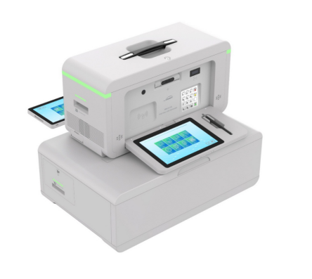
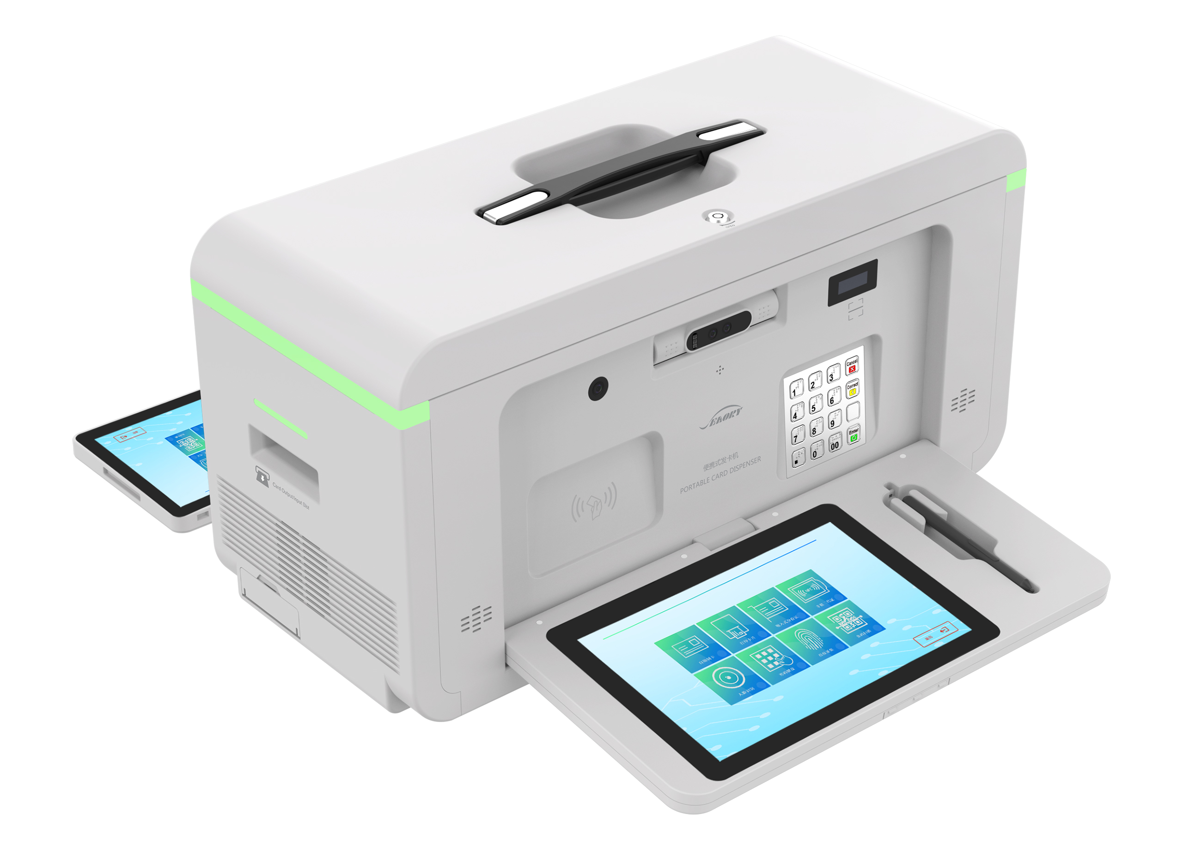
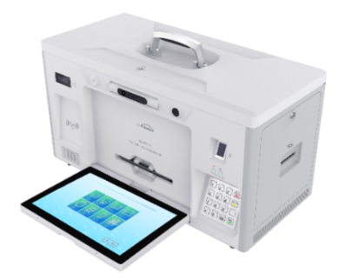
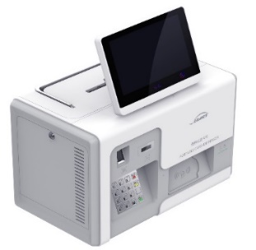
E Series Portable Card Dispenser
Pictures
Model | E300(Dual-sided DTC) | E80B | E80C | E70
Features | 1. Print Resolution: 300*300, 300*600,300*1200 dpi 2. Input hopper capacity: 100 cards 3. Print Speed: ■Monochrome single side 4s/card ■Full-color(YMCK) single side 20s/card, dual side 42s/card ■27s~120s according to the standard issuing timeof bank card/credit card 4. Print Dimention: ISO CR80(53.98mm*85.6mm) 5. Screen: Front 10.1inch LCD touch screen Back(optional) 10.1inch LCD touch screen 6. Operatin system: Windows, Android,Linux, or window+Android | 1. Print Resolution: 300*300, 300*600,300*1200 dpi 2. Input hopper capacity: single side 70 cards / dual side100 cards 3. Print Speed: ■Monochrome single side 4s/card , dual side the front print +back identing 27s ■Full-color(YMCK) single side 20s/card, dual side 42s/card(the front print+back identing) 4. Print Dimention: ISO CR80(53.98mm*85.6mm) 5. Screen: Front 10.1inch LCD touch screen Back(optional) 10.1inch LCD touch screen 6. Operatin system: Windows, Android,Linux, or window+Android | 1. Print Resolution: standard 300*300 dpi, Optional 300*600,300*1200 dpi 2. Input hopper capacity: single side 70 cards / dual side100 cards 3. Print Speed: ■Monochrome single side 3~5s/card , dual side 7~12s ■Full-color(YMCK) single side 20s/card, dual side 42s/card 4. Print Dimention: ISO CR80(53.98mm*85.6mm) 5. Screen: optional 8 inch or 10.1inch LCD touch screen, support handwriting 6. Operatin system: Windows, Android,Linux, Neokylin, Kylin, UOS, etc. | 1. Print Resolution: standard 300*300 dpi, Optional 300*600,300*1200 dpi 2. Input hopper capacity: single side 70 cards / dual side100 cards 3. Print Speed: ■Monochrome single side 3~5s/card , dual side 7~12s ■Full-color(YMCK) single side 20s/card, dual side 42s/card 4. Print Dimention: ISO CR80(53.98mm*85.6mm) 5. Screen: optional 8 inch or 10.1inch LCD touch screen, support handwriting 6. Operatin system: Windows, Android,Linux, Neokylin, Kylin, UOS, etc.
Optional multi-function module | 1.Contact & contactless encoding module 2.Hico&Loco 1/2/3 tracks magnetic card encoding module 3.Barcode & QR code scaning module 4.WIFI, bluetooth, 4G/5G, remote communication module 5.Identing & embossing module | 1.Contact & contactless encoding module 2.Hico&Loco 1/2/3 tracks magnetic card encoding module 3.Barcode & QR code scaning module 4.WIFI, bluetooth, 4G/5G, remote communication module 5.Identing module | 1.Contact & contactless encoding module 2.Hico&Loco 1/2/3 tracks magnetic card encoding module 3.Barcode & QR code scaning module 4.WIFI, bluetooth, 4G/5G, remote communication module 5.Identing module 6. UCR module | 1.Contact & contactless encoding module 2.Full three-tracks magnetic card encoding module 3.Barcode & QR code scaning module 4.WIFI, bluetooth, 4G/5G, remote communication module 5.Suction type card scanning module
-16-

Slide 14
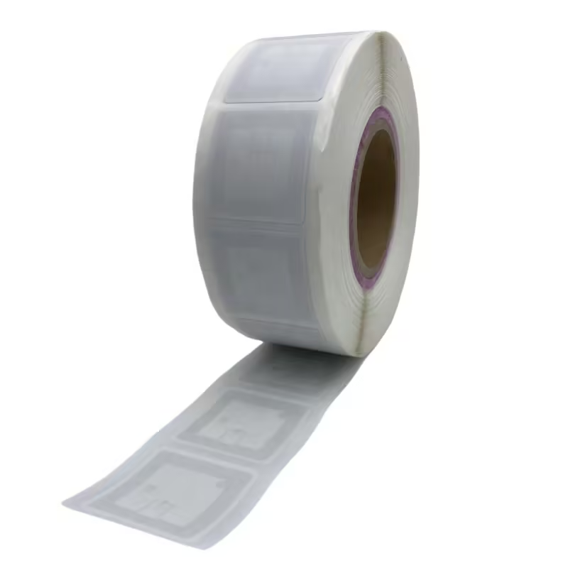

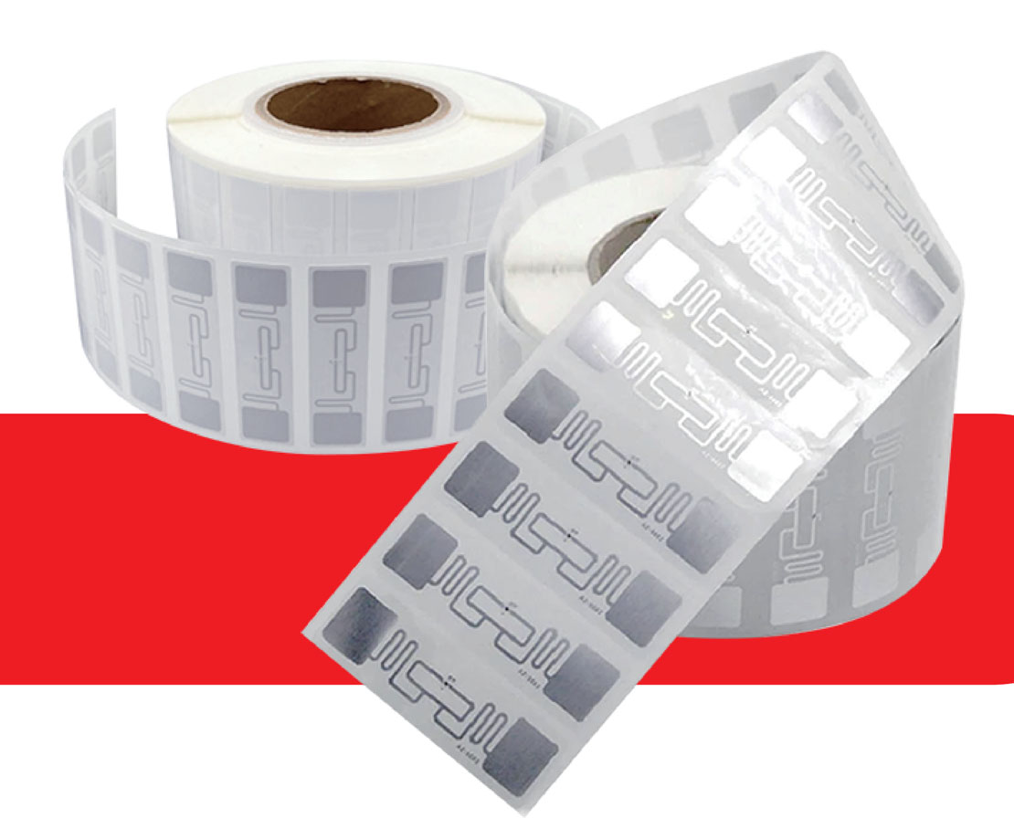
RFID Label
RFID Label can help your business
Supply Chain Management
Industry
Logistics
Retail
Hospitals
Food and Drinks
Library and document
Sports timing
Identification and Location of Assets
Inventory Management
Access Control
-12-

Slide 15
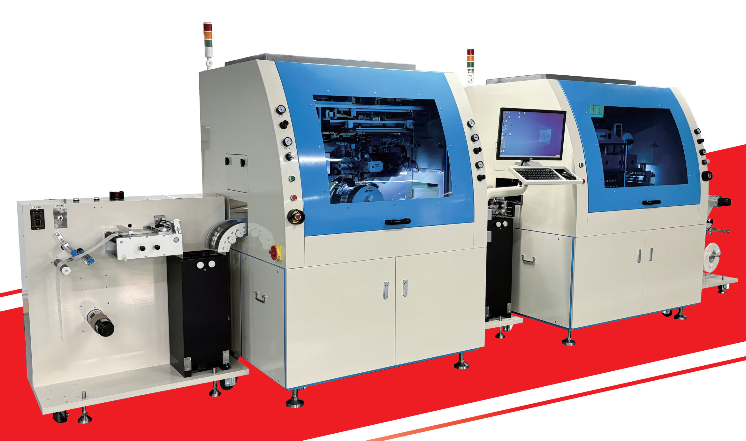
RFID Tags Manufacturing Equipements
Unwinder
RFID Flip-chip Attach Bonding System
Adhesive Jetting
&
Pre-bond
Final Bond
Upwinder with Tester and Marker

Slide 16
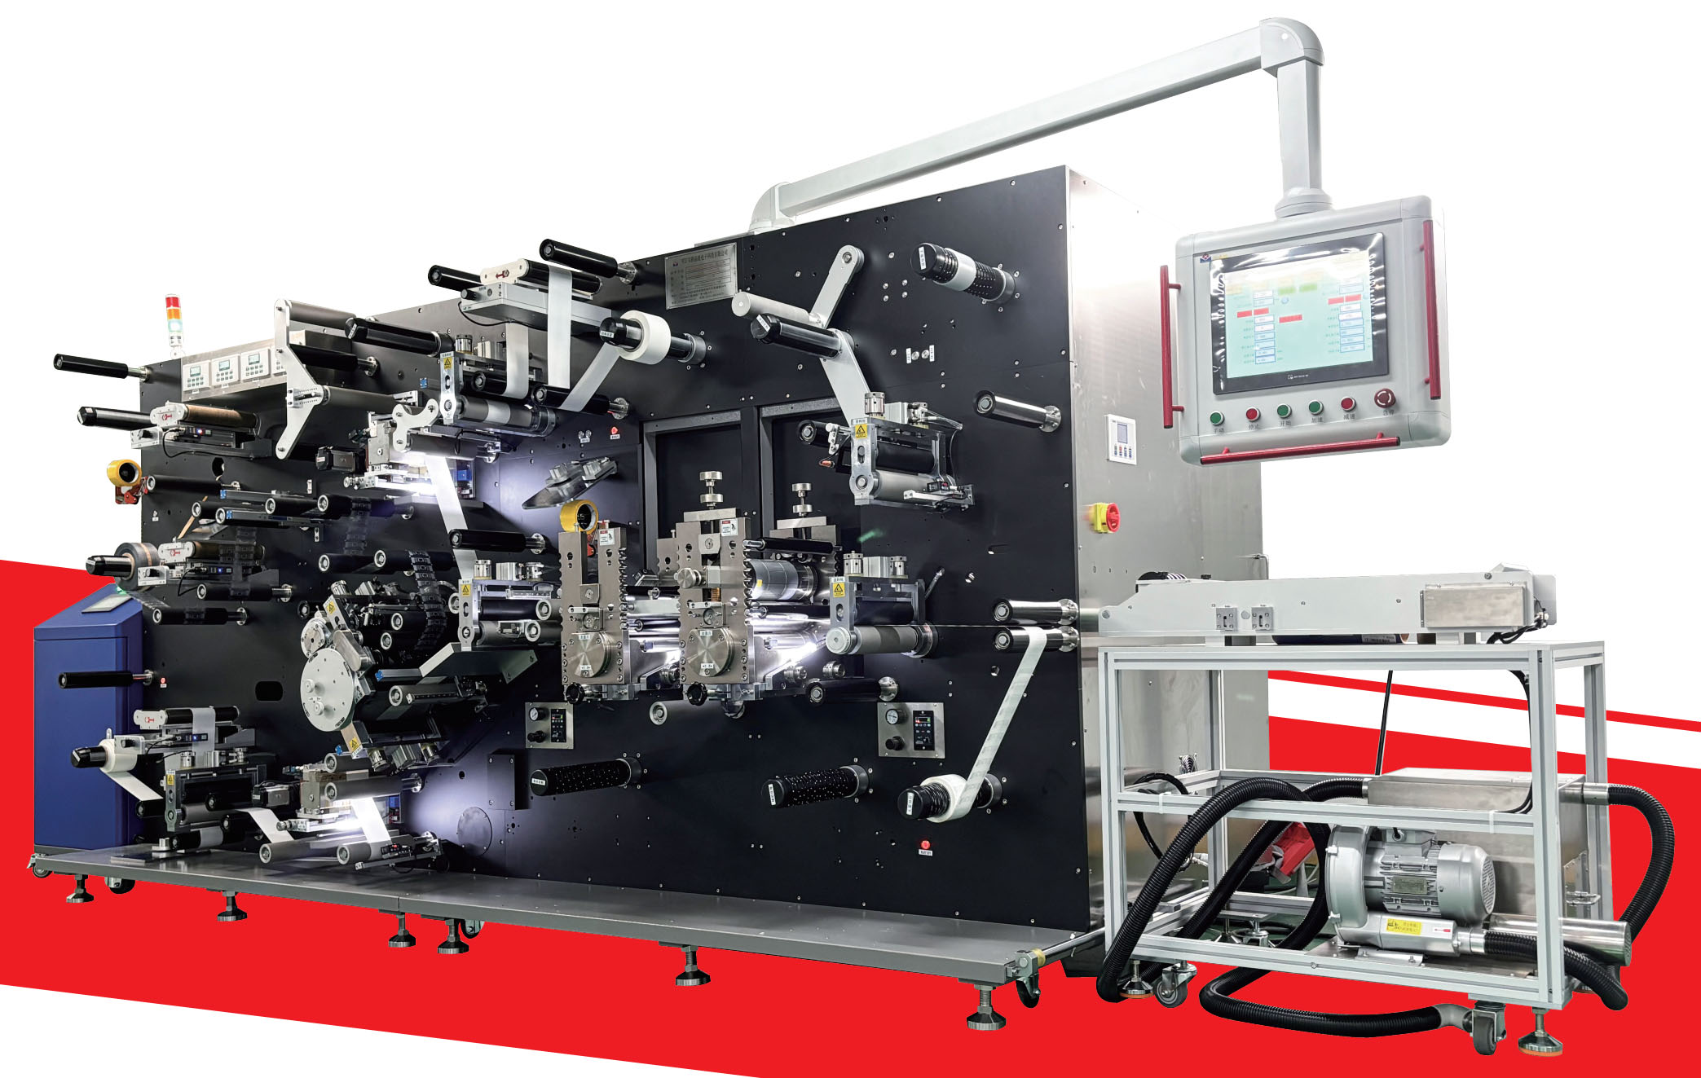
RFID Converting and Lamination Line
2 Million A Day

Slide 17
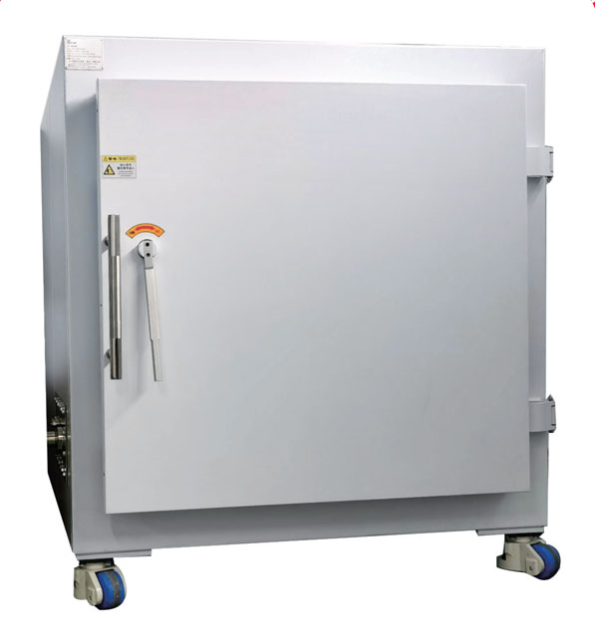
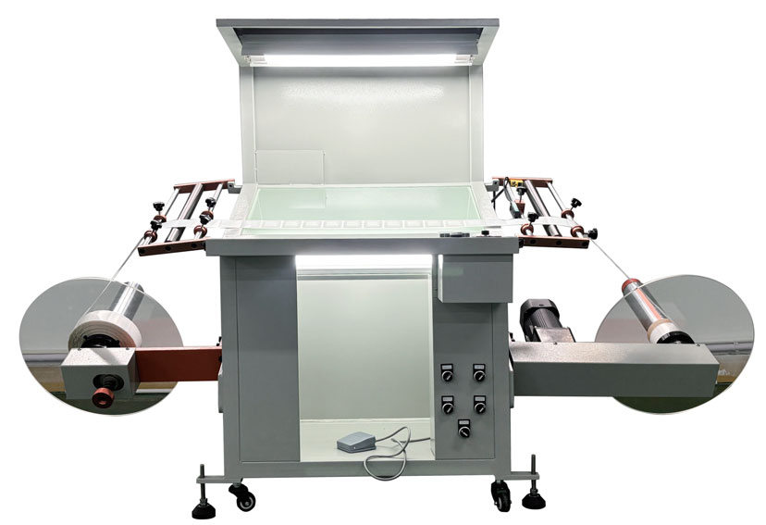
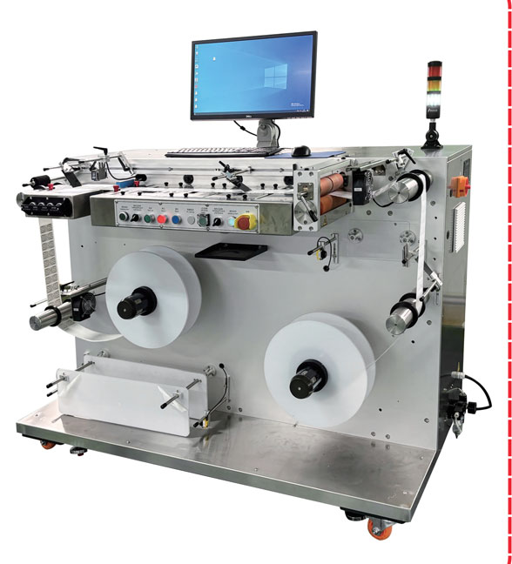
RFID Tags Testing
Appearance Inspection
Reading/encodeing Functional Test
Reading/encodeing distance Test

Slide 18
3
Seaory Soft Power
-17-

Slide 19
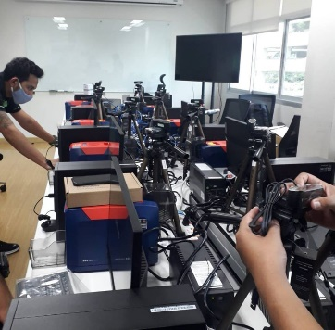
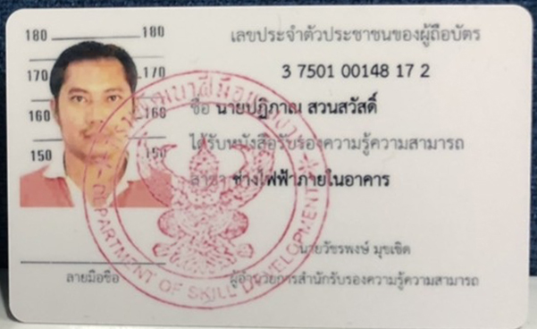
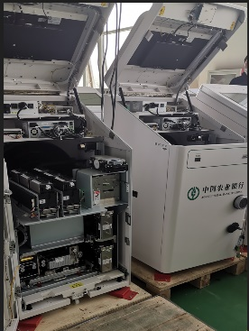
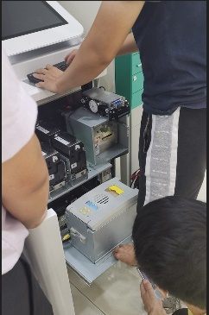
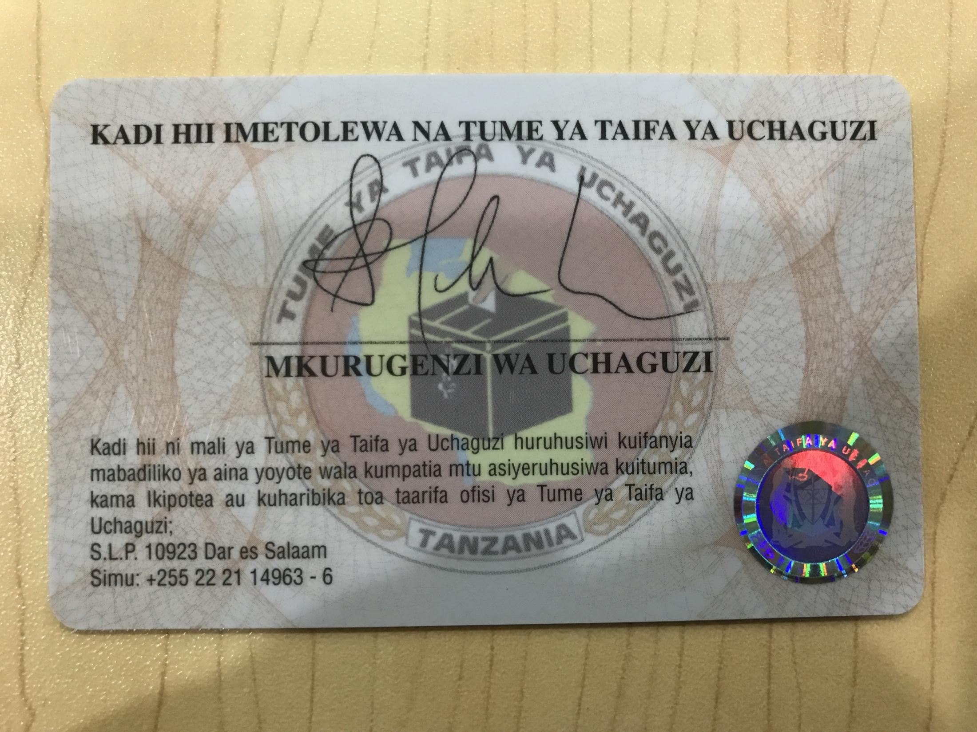
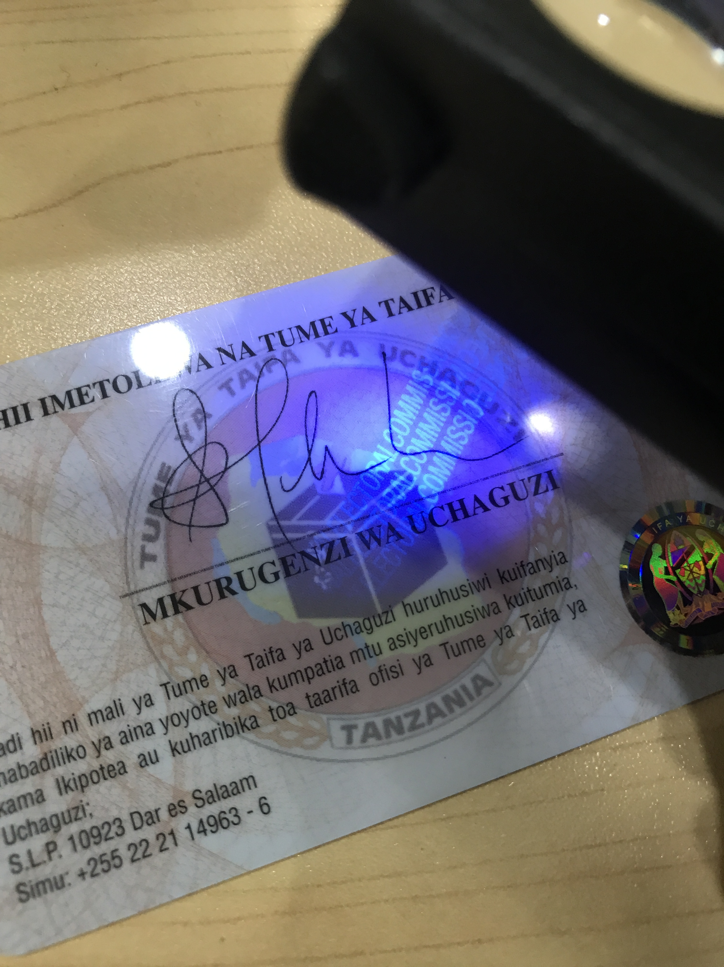
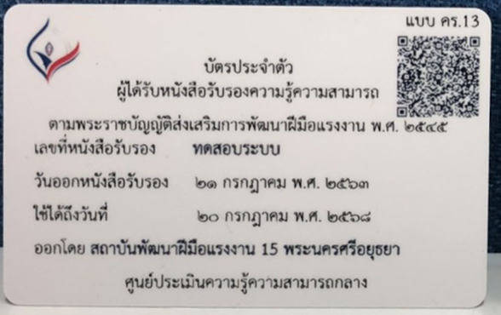
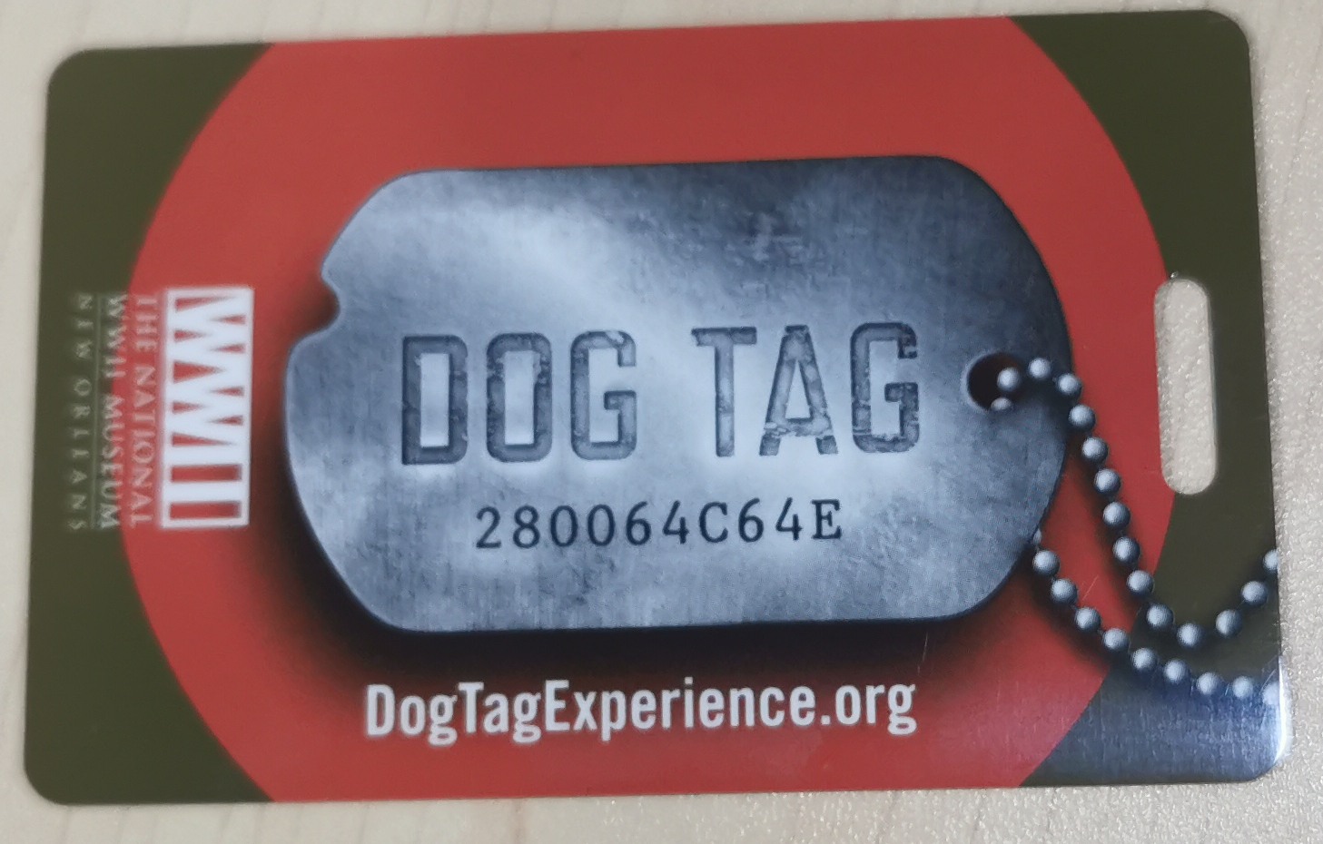

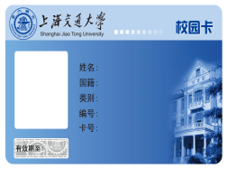
Successful Projects
Department of Labor in Thailand
In 2019, S21 is used for
dispensing Labor Cards
ABC Bank of China in 2020
S22K install inside Kiosk
for dispensing social security cards
Tanzania Election Card
March 2015
president election project, 32 million cards
Lots of confidential projects in different industry: ID card, Driver License, Airport, Checkpoint, Casino, etc.
Aemerica World War II Museum
Since 2014
World War II Museum project
Shanghai Jiao Tong University
Campus card, student card, teacher card
Foxconn Employee ID card &
ID card printer/consumables
-18-

Slide 20



Seaory Current Distribution Area
Switzerland
UK
Russia
Canada
Spain
Germany
U.S
Portugal
Turkey
Seaory China
Algeria
Pakistan
India
Thailand
Philippines
Indonesia
LatAm
New Zealand
-19-

Slide 21
Seaory Strengths
R&D
Production Capacity
Quality
*20+ R&D engineers
*Strong R&D capabilities
*Fast speed on R&D
*Fast delivery
*Printers: 5,000/month
*Smart cards:1 Million/month
*RFID labels: 2 Million/month
* Low repair rate
* Low complaints
* Successfully applied in different industries
* Achieved good reputations
Comprehensive & Flexibility
Market protection policy
After-sales service
*Card printer+Card+Multi-module integrated card dispenser
*Available to provide one-stop *solution for any projects and customized solution for reasonable special demands
*As a Seaory formal authorized distributor, will receive a certificate of authorization, customer resources in the specific regions.
*Fast response speed
*Extended service hours
*Remote assistance of addressing technical issues
*On-the-spot technical training
-20-

Slide 22



Seaory Vision
Together, we win the future.
At Seaory, we treat all our partners as true members of our team and a larger extension of our team. In this spirit of customer first that we wholeheartedly create a "win-win" cooperation model.
-21-

